Slide 1


Introduction to Core Bluetooth
Understanding the Basics of Using Core Bluetooth
ChrisMarshallNY (Google-Friendly)
Chris@RiftValleySoftware.COM
Notes:
Mention “Google-Friendly” and email
Quick anecdote about device control.
Mention the chaotic nature of device control software.

Slide 2
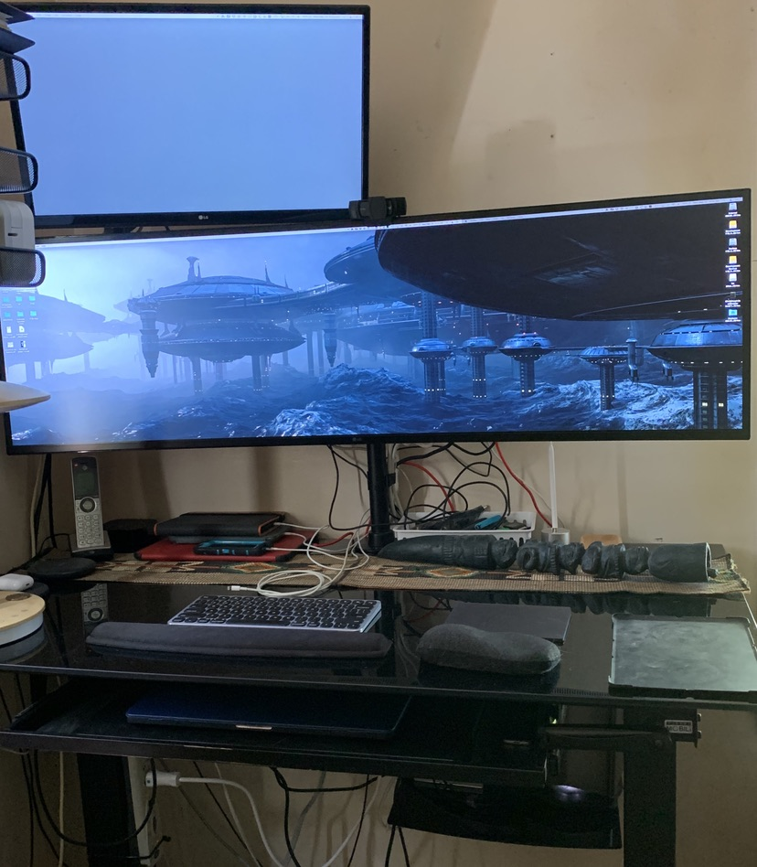

Slide 3



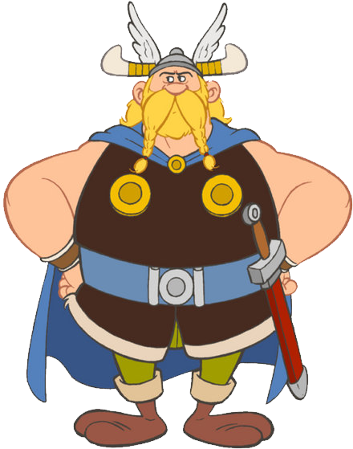
HARALD
“BLUETOOTH”
Notes:
Mention Harald Bluetooth.
Jim Kardach (Intel) made up the name.

Slide 4
BLUETOOTH CORE IS BIG
...CORE BLUETOOTH IS SMALL
Notes:
Bluetooth is a HUGE specification.
It covers billions of devices.
It needs to take an “all things, to all men” approach.
Anecdote about figuring out what to cover.
-CLICK-
Core Bluetooth is Apple’s “window” into Bluetooth.
Note that Apple probably knows more about Bluetooth than almost any corporation out there; yet has chosen to make Core Bluetooth a very “lite” version.

Slide 5
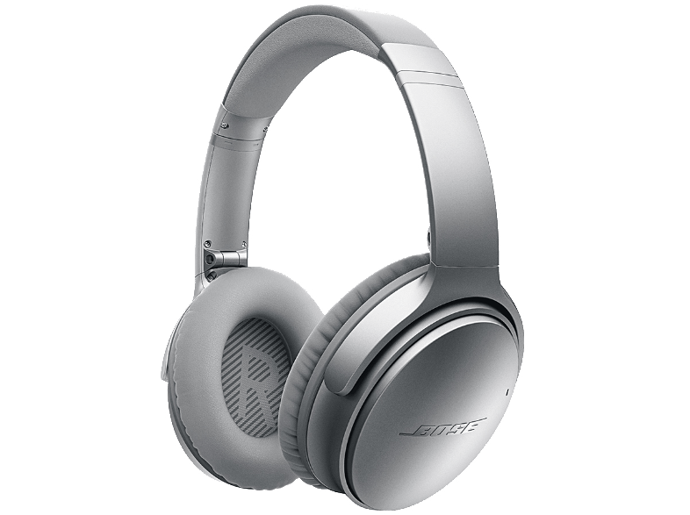
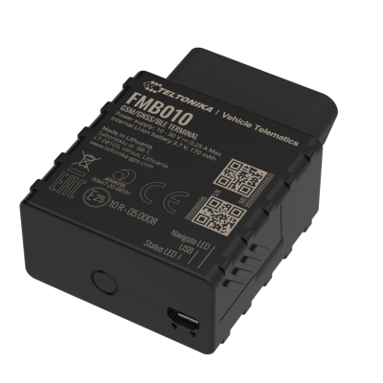
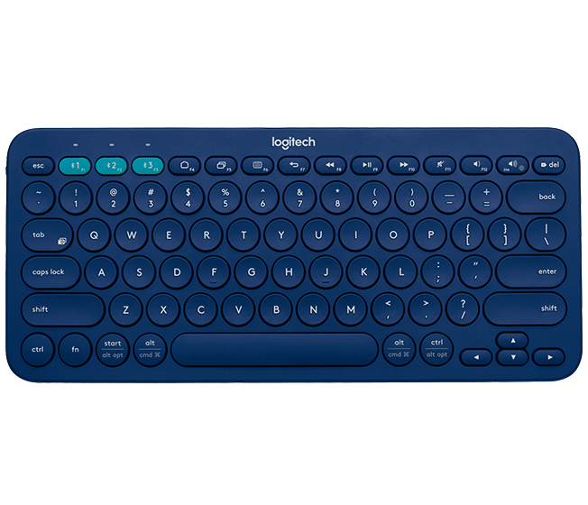
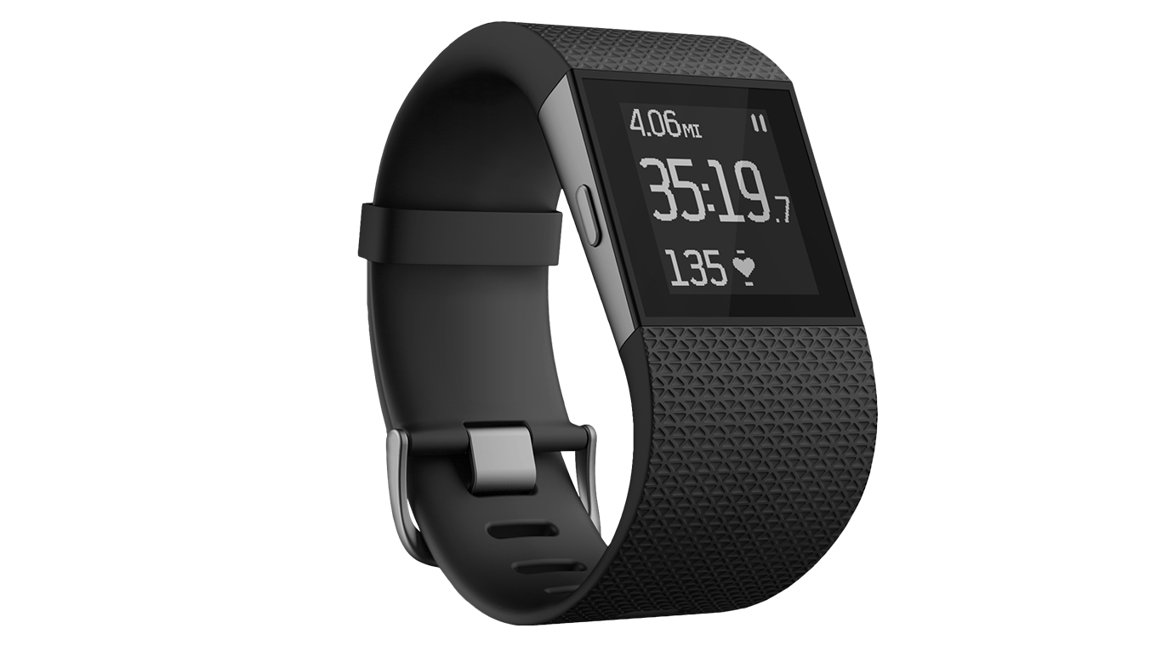
TWO FLAVORS OF BLUETOOTH
BR/EDR
(CLASSIC)
BLE
(LOW-ENERGY)
Notes:
Basic Rate/Enhanced Data Rate, or Classic
Keyboards and mice, or headphones
- CLICK –
Bluetooth Low-Energy
OBD adapters or fitness trackers
- CLICK –
We will be concentrating on BLE.
There is some rather casual support in Core Bluetooth for Classic, but we will concentrate on BLE.

Slide 6




BLE Advertising: The Story of Dave and Matt
Notes:
Dave is a Peripheral (Server)
Matt is a Central (Client)

Slide 7
Basic BLE Structure
CHARACTERISTIC
SERVICE
PERIPHERAL (Server)
CHARACTERISTIC
SERVICE
CHARACTERISTIC
CHARACTERISTIC

Slide 8



Basic BLE Structure
PERIPHERAL (Server)
SERVICE
SERVICE
SERVICE
CHARACTERISTIC
CHARACTERISTIC
CENTRAL (Client)
CHARACTERISTIC
CHARACTERISTIC
CHARACTERISTIC
SERVICE
SERVICE
CHARACTERISTIC
CHARACTERISTIC
CHARACTERISTIC
CHARACTERISTIC
Notes:
Talk about how the Peripheral is always in charge of the relationship.

Slide 9

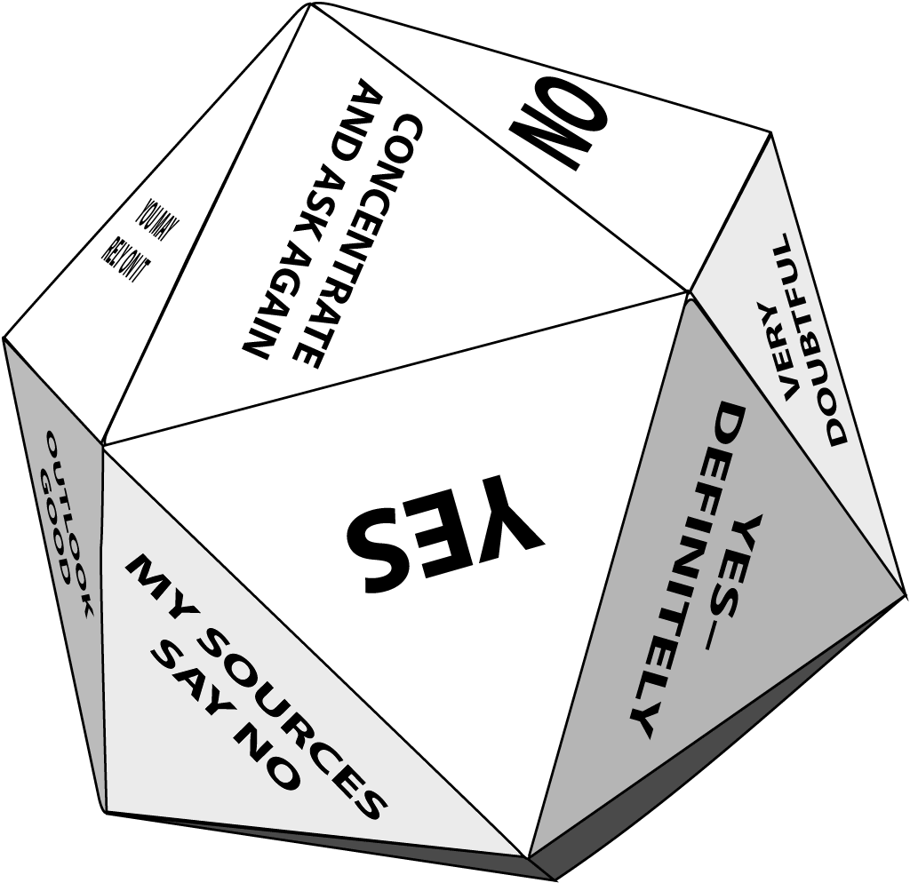


The Basic Structure Of Our Bluetooth Apps
CENTRAL
Bluetooth Magic 8-Ball
PERIPHERAL
(Client Behavior)
(Server Behavior)

Slide 10




The Basic Structure Of Our Bluetooth Apps
CENTRAL
PERIPHERAL
CBCentralManager
CBPeripheralManager
CBMutableCharacteristic
CBPeripheral
CBMutableService
CBService
CBCharacteristic
CBMutableCharacteristic
CBCharacteristic

Slide 11
The Basic Structure Of Our Bluetooth Apps
CBCentralManager
CENTRAL
PERIPHERAL
CBPeripheral
CBService
CBCentralManager
CBPeripheralManager
CBCharacteristic
CBPeripheral
CBMutableService
CBCharacteristic
CBService
CBMutableCharacteristic
CBPeripheral
CBPeripheralManager
CBCharacteristic
CBService
CBMutableCharacteristic
CBMutableService
CBCharacteristic
CBCharacteristic
CBMutableCharacteristic
CBCharacteristic
CBMutableCharacteristic

Slide 12
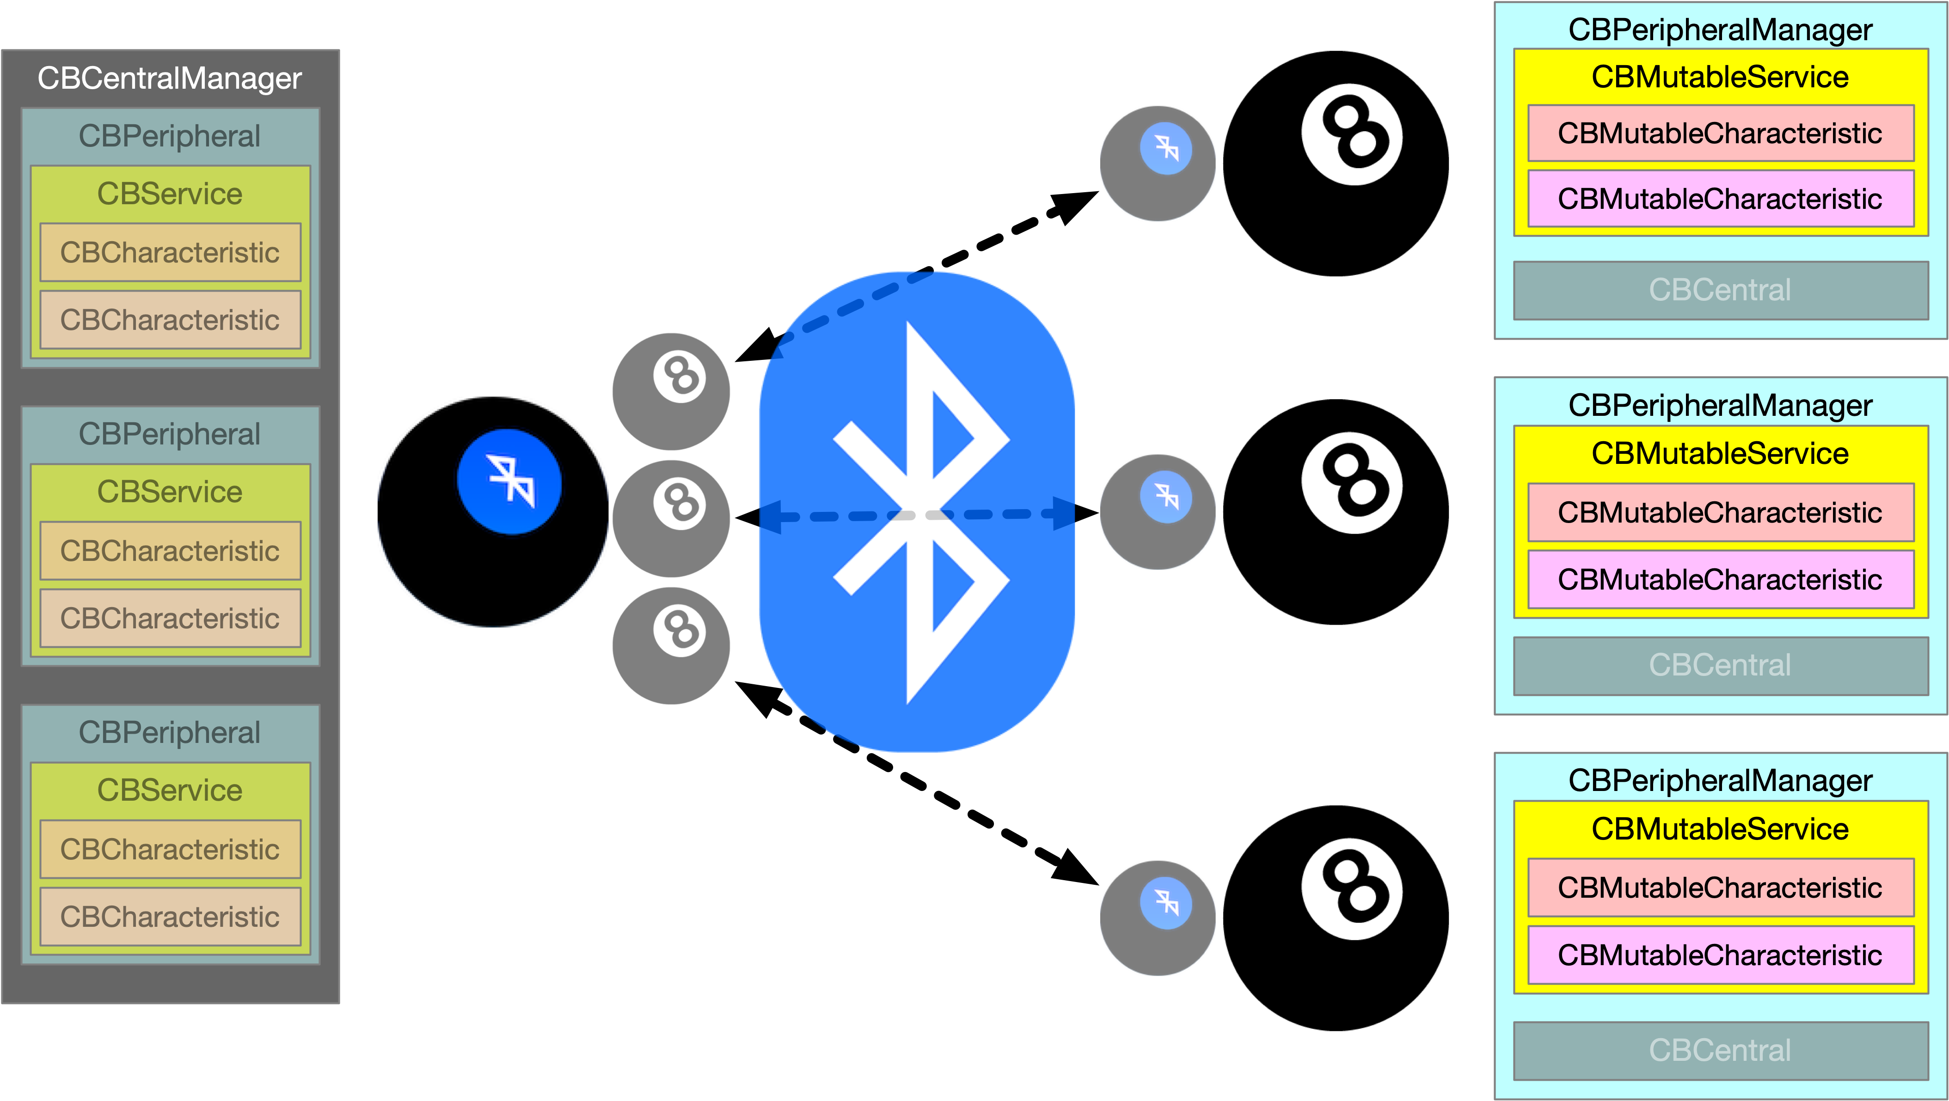
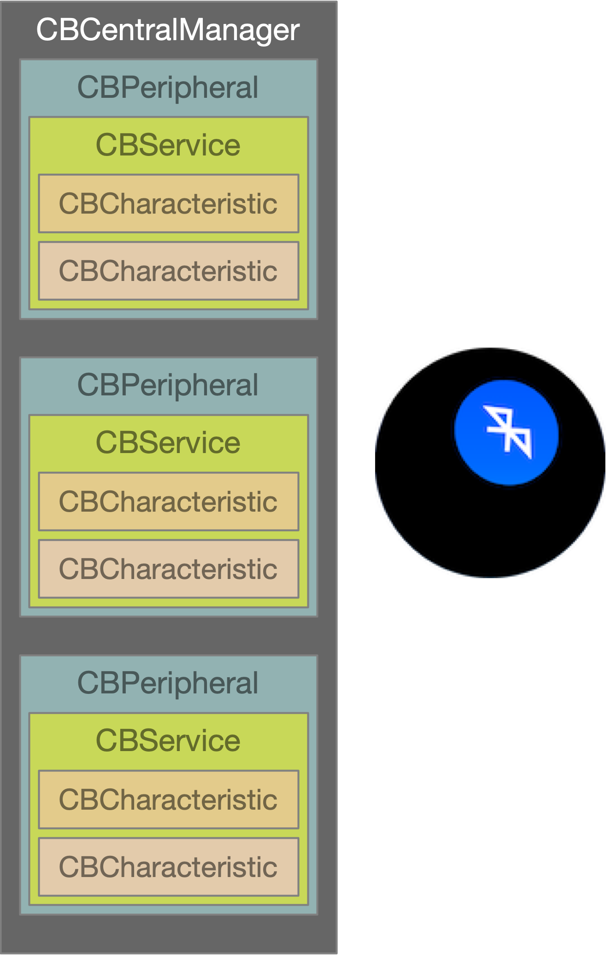
The Basic Structure Of Our Bluetooth Apps

Slide 13
LET’S CODE!

